Slide 1
LINE TYPES
LINES
Lines are like the alphabet of a drawing language. Each line in a drawing is used in a specific sense.
Types of Lines
The basic types of lines are shown in Table along with their applications.
Lines differ from each other in two respects:
Their thickness or weight eg:- Thick, Medium & thin.
Their Shape or construction depending upon their conventional use.
Pencil Grades
An HB grade pencil is advised for THICK lines. THIN & medium lines may be drawn by a H grade pencil.

Slide 2
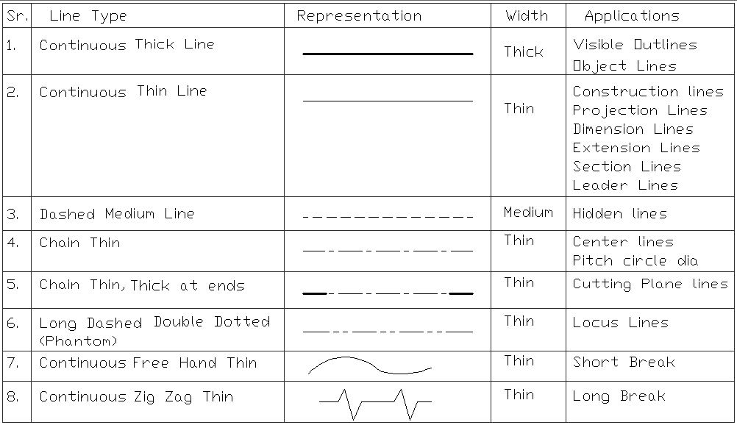
TYPES OF LINES:-

Slide 3
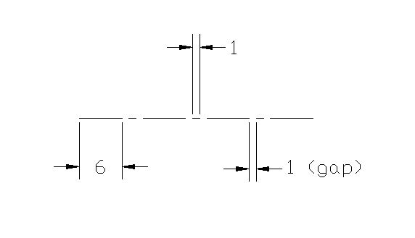
Center Line Construction:-

Slide 4
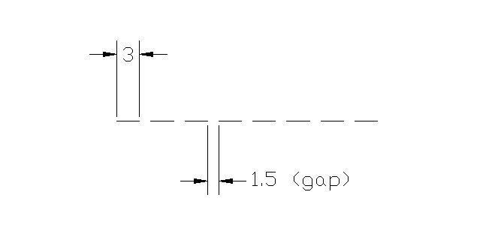
Hidden Line Construction:-

